Slide 1

Pfa housing report
By:----Seep bansal

Slide 2
INTRODUCTION
Houses are one of the necessary need of each and every person around the globe and therefore housing and real estate market is one of the markets which is one of the major contributors in the world’s economy. It is a very large market and there are various companies working in the domain.
A US-based housing company named Surprise Housing has decided to enter the Australian market. The company uses data analytics to purchase houses at a price below their actual values and flip them at a higher price. Dataset has been provided in the form of test and train data where we will be using training dataset to train the data and test dataset has been given where we are supposed to predict the sale price on the basis of various features provided

Slide 3
PROJECT SUMMARY
Though it is one of the most challenging task to understand what factors actually influence the housing price. The focus of this project is developing machine learning models that can accurately predict the housing price based on its id, msclass, lotarea, street, utilities, neighborhood, basement details and many more.
Various machine learning algorithms like Linear Regression, Support Vector Mechanism, Decision Tree Regressor, Random Forest Regressors, K Neighbours Regressor are implemented and evaluated to predict the housing sale price.
The best results are given by Random Forest Regressor.
Though conventional Linear Regression also gave the good results with the advantage of significantly lower training time as compared to the aforementioned algorithm

Slide 4
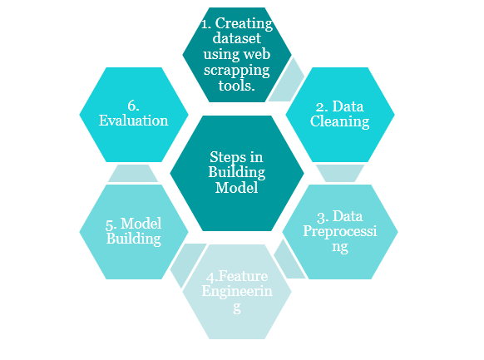

Slide 5
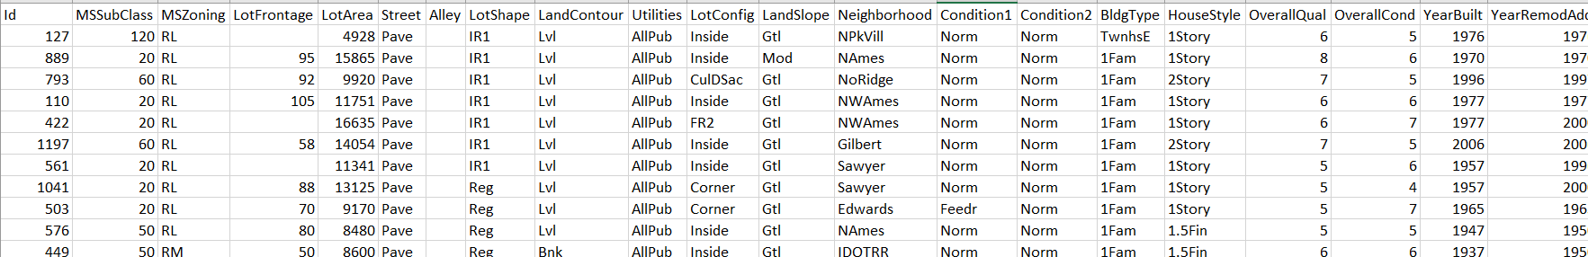
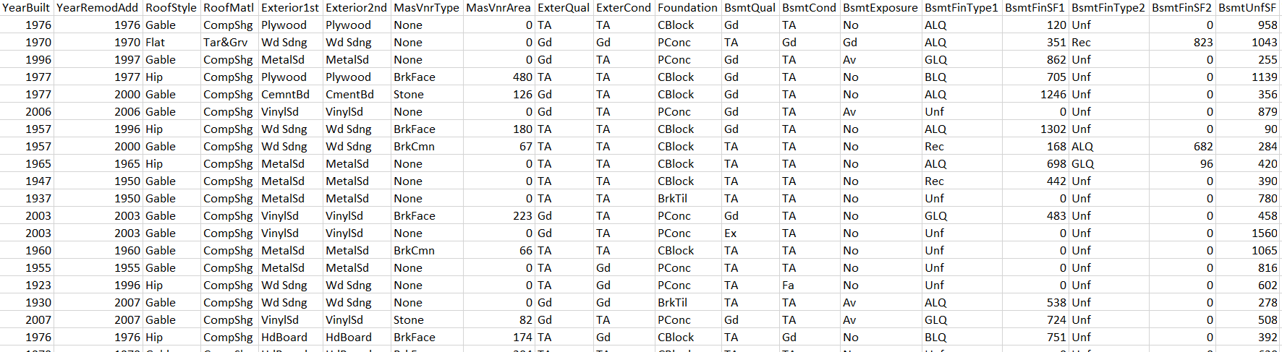
DATASET
For this project, the company has collected a data set from the sale of houses in Australia. The data for training and testing has been provided in separate csv files. To train the data we will be using the train dataset and for testing purpose will be using the test dataset. Train dataset contains 1168 rows and 81 columns while the test dataset contains 292 rows and 80 columns.

Slide 6
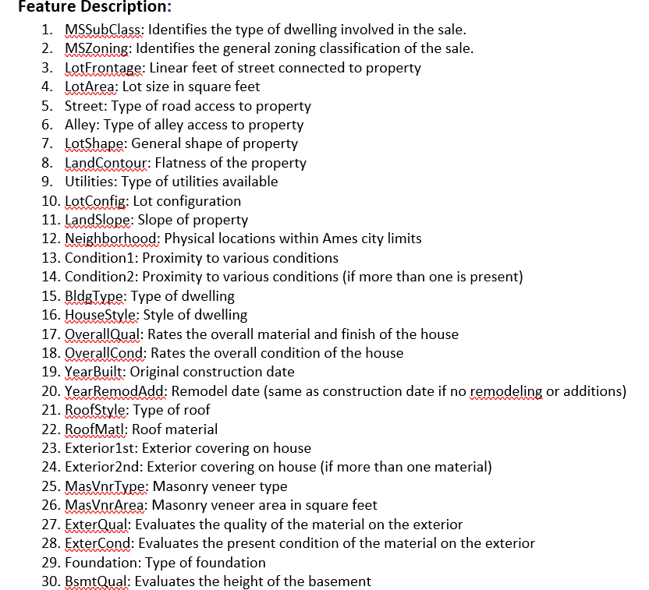
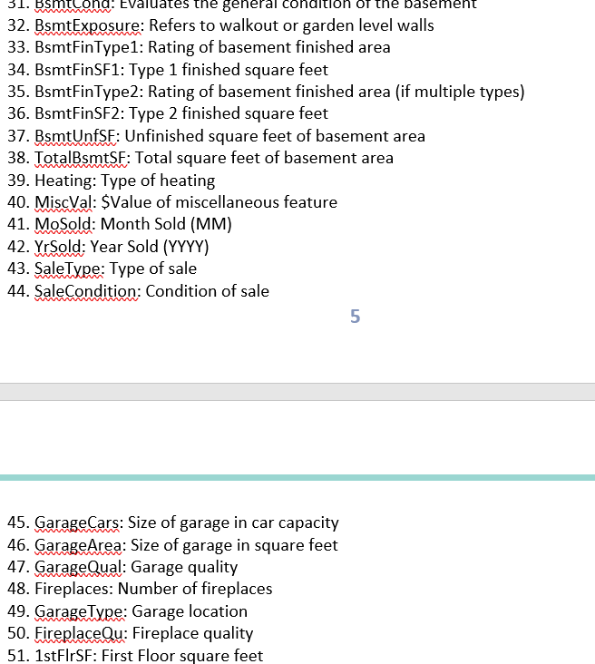

Slide 7
DATA PREPROCESSING
Preprocessing is one of the important steps in building a model. In this phase we usually deal with missing values if any or if there are any unrealistic values. In case of any irrelevant value, we will remove that data.
In case if the data loss is huge then removing/dropping of data is not a good practice. We will try to improve the quality of data in this phase so that we can develop a model with high accuracy score.
For the dataset, we will first of all fill the missing values if any, then we have most of the data in categorial form we will convert the data in numerical form so that we are able to fed the data into classification algorithms. We can also check if there exist any multicollinearities through VIF FACTOR calculation.

Slide 8
EDA CONCLUDING REMARKS
There are null values in the dataset.
Outliers are there but removing outliers leads to huge data loss so dropping the data may result in important information.
Calculation of VIF Factor to check the presence of multicollinearities among the difference variables.
As the data is highly skewed using a power transformation method ‘yeo-Johnson’ to get rid of skewness.
Some of the features were dropped while passing the data to the model as they were giving no contribution in predicting the output variable and were affecting the computational time.
We will be performing standard scaling technique to bring all the columns on the same scale.
The data types of the columns were changed from string to numeric type.
Feature extraction were performed i.e many new features were extracted from the existing features.

Slide 9
VISUALIZATION

Slide 10
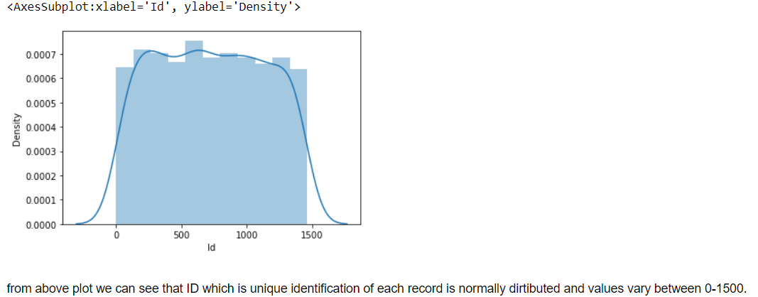
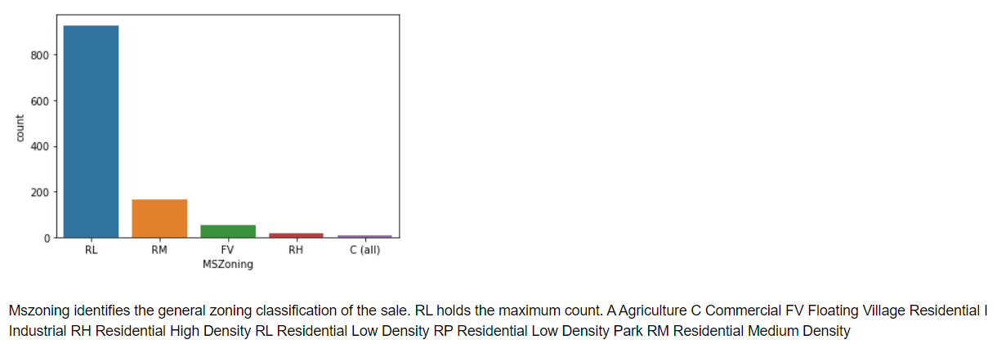
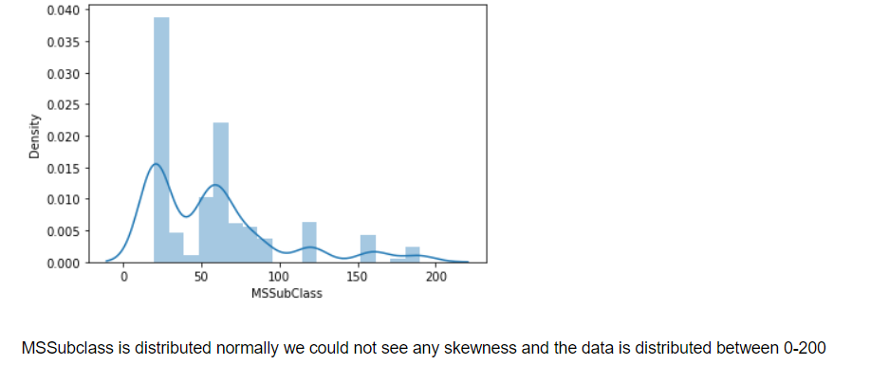

Slide 11
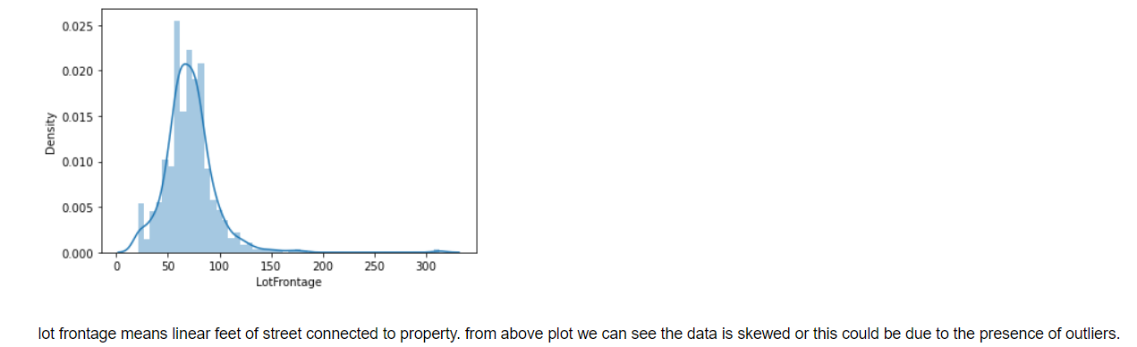
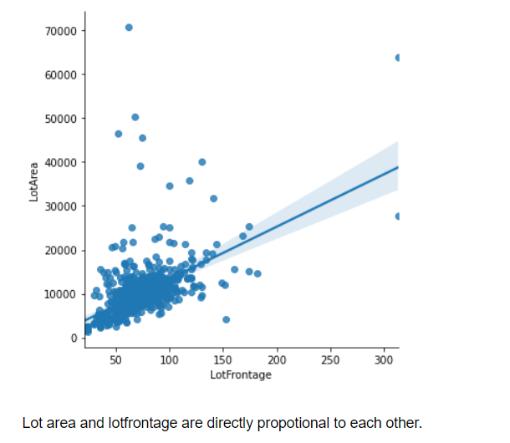
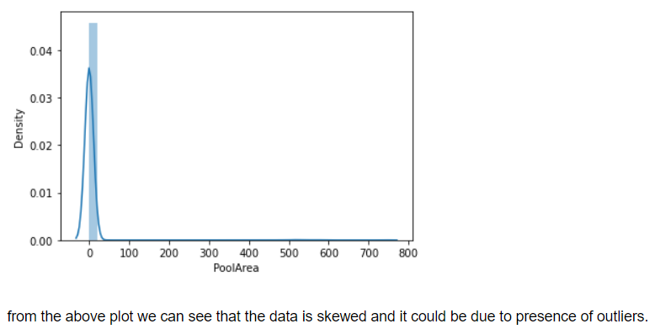

Slide 12
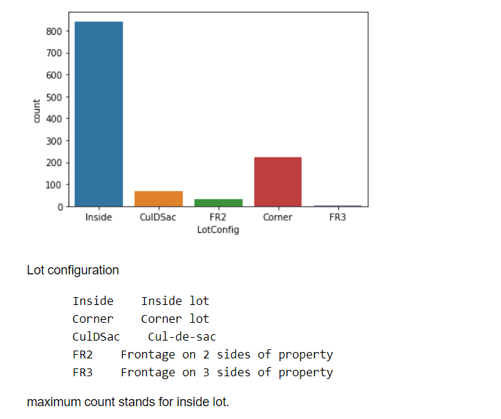
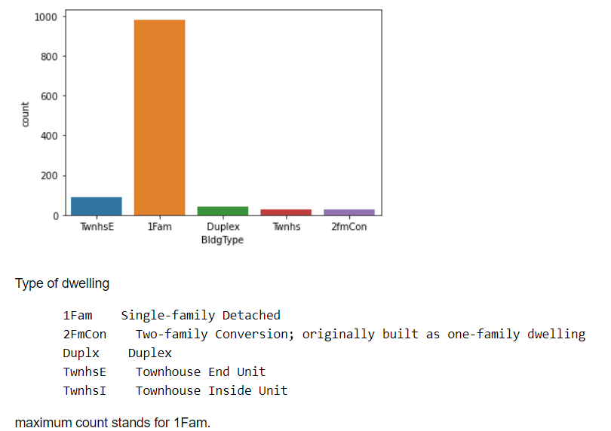

Slide 13
ALGORITHMS USED For Training and Testing the Model:
Linear Regression Model
Decision Tree Regressor
Random Tree Forest Regressor
K Neighbors Regressor
Support Vector Regressor

Slide 14
REGRESSION EXPERIMENTS
We have performed various Regression algorithms like Linear Algorithm, Decision Tree Algorithm, Support vector Regressor, K Neighbors Regressor, Random Tree Regressor to check the MSE, MAE, RMSE. The main algorithm which has predicted the best results is the Random Forest Tree Regressor. Random forest regression is an ensemble learning technique which takes multiple algorithms or same algorithm multiple times and put together a model that’s more powerful than the original.

Slide 15
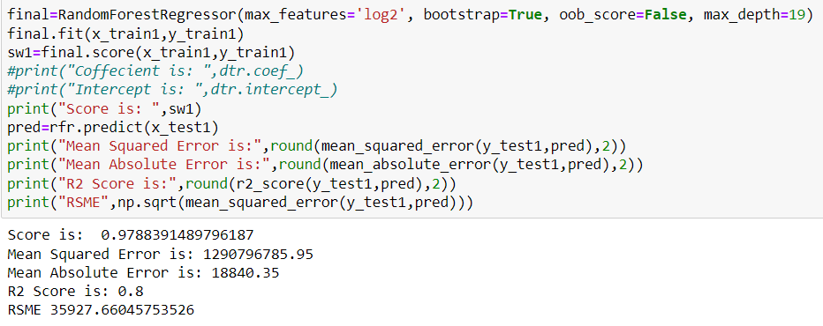
EVALUATION
Evaluation of model plays a very important role in evaluating the performance of any Regression. The metrices that are evaluated here are the R2 score, MSE, MAE, RMSE.Time taken to test the model on dataset plays a very crucial role.Here, for Random Tree Forest Classifier the accuracy score we are getting is 97% and the RMSE is 35927 which is least in any of the model build and the computational time is very less.

Slide 16
CONCLUSION
Though it is very difficult to decide the price of the house by the various variables provided by the client by developing this model and performing different algorithms was aimed to get the different perspectives.
The main aim of building this model was to quote the price of car in such a way that makes easy for sellers to sell and buyers to buy.
The various data visualization techniques were used. Data was analyzed from different point of views many preprocessing techniques like scaling, label encoding etc were followed.
The relation between different features were examined and the best model Random Forest Regressor was used to predict the best price of the house.

Slide 17
LIMITATIONS AND FUTUTRE SCOPE
The above model is used to predict the price of the house on the basis of the dataset provided by the client. However, this was relatively a small dataset with around 1168 rows was used make a strong inference.Room of improvement is more data preprocessing and more data cleaning techniques to be followed which could help is reducing RMSE. We could actually build this model with different scaling technique like min-max scaler which may give us better results or we could also try different encoding technique which may enhance the results.

